Slide 1
Approximation Algorithms

Slide 2
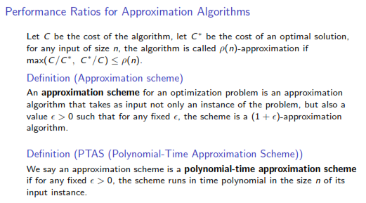

Slide 3
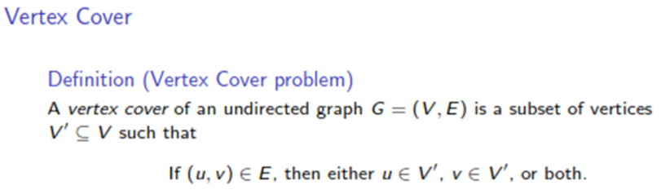


Slide 4
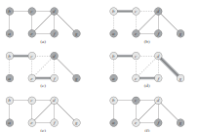

Slide 5
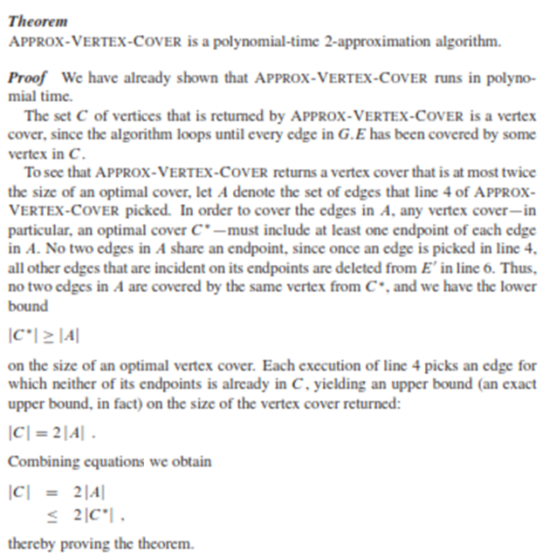

Slide 6


Travelling Salesperson Problem

Slide 7
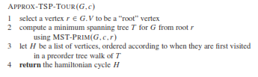

Slide 8
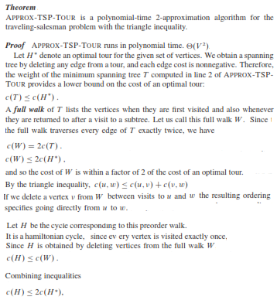

Slide 9
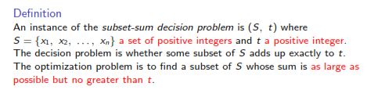
SUM OF SUBSETS PROBLEM

Slide 10
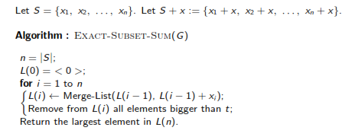
EXACT ALGORITHM

Slide 11
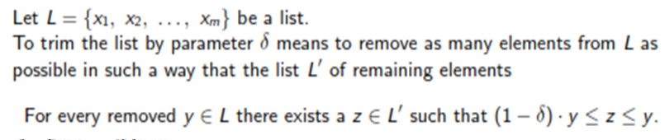

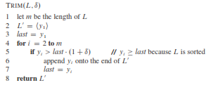
TRIM

Slide 12
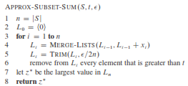
APPROXIMATE ALGORITHM

Slide 13
SET COVERING PROBLEM
An instance (X,F) of the set-covering problem consists of a finite set X and a family of subsets of X, such that every element of X belongs to at least one subset in F
A subset S ϵ F is said to cover X, if the union of all elements of S gives X
The set covering problem is to find a minimum size subset C ϵ F such that it covers X

Slide 14
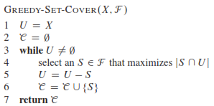
GREEDY ALGORITHM

Slide 15
Example
X = {1, 2, 3, 4, 5, 6, 7, 8, 9, 10, 11, 12}
F = {S₁, S₂, S₃, S₄, S₅, S₆}
Where
S₁ = { 1, 2, 3, 4, 5, 6}
S₂ = { 5, 6, 7, 8}
S₃ = {1, 4, 7, 10}
S₄ = {2, 5, 7, 8, 11}
S₅ = {3, 6, 9, 12}
S₆ = {10, 11}

Slide 16
SOLUTION
Greedy Solution:
{S₁, S₃, S₄, S₅} or
{S₁, S₄, S_{5,} S₆}
Optimal Solution
{S₃, S₄, S₅}

